Slide 1
The Health Assessment of Inhaled Particles Deposition in the Nasal Cavity
PhD Candidate: Yidan Shang
Primary supervisor: Prof. Jiyuan Tu
Second supervisor: Dr. Kiao Inthavong
Notes:
Information to help you understand how the committees work and help you act as a student member.

Slide 2
Outline
Background and literature review
Part 1: Nasal geometry models reconstruction
Part 2: A novel technique, Surface-mapping
Part 3: Particle deposition influenced by the breathing region
Part 4: Comparative deposition study between human and rat
Conclusion and future work
Publication

Slide 3
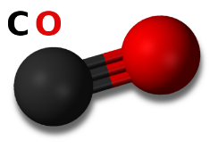
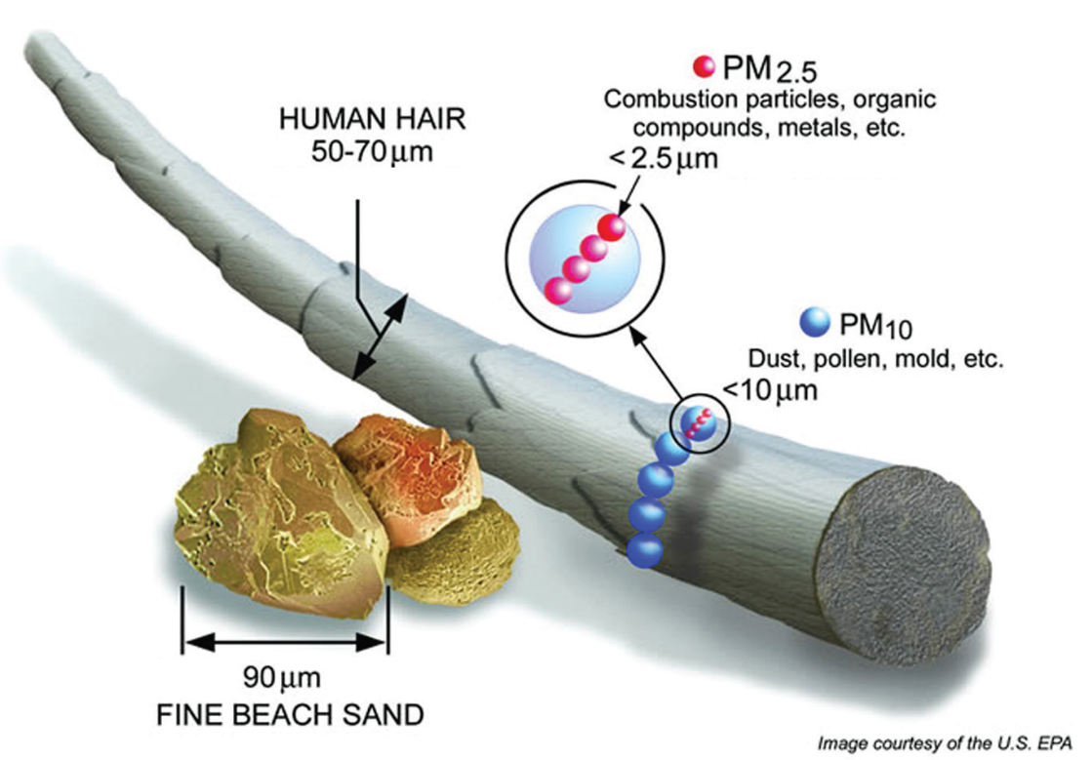
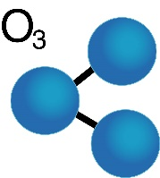
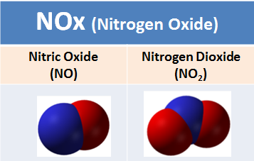
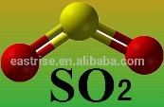

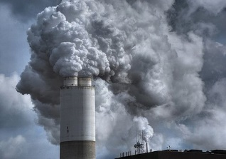
Air pollution
Seven million premature deaths annually –World Health Organisation (WHO) 2014
Six most widespread air pollutants –Environmental Protection Agency (EPA) Victoria
Carbon monoxide
Ozone
Oxides of nitrogen
Sulfur dioxide
Volatile organic compounds
Particulate matters
PM10 and PM2.5
Nano size
Micro size
Size comparison of PM against hair and sand
Notes:
Overview:
Committees, membership, agenda
Meeting
Following meeting: “housekeeping”, questions

Slide 4
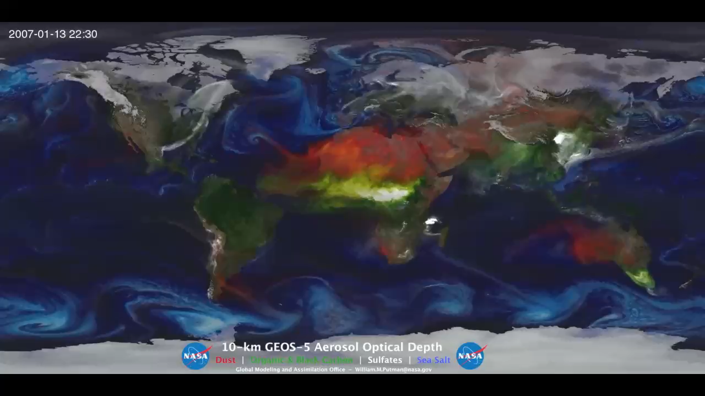
Global atmospheric pollution recirculation
Red: dust Green: organic White: sulfates Blue: sea salt

Slide 5
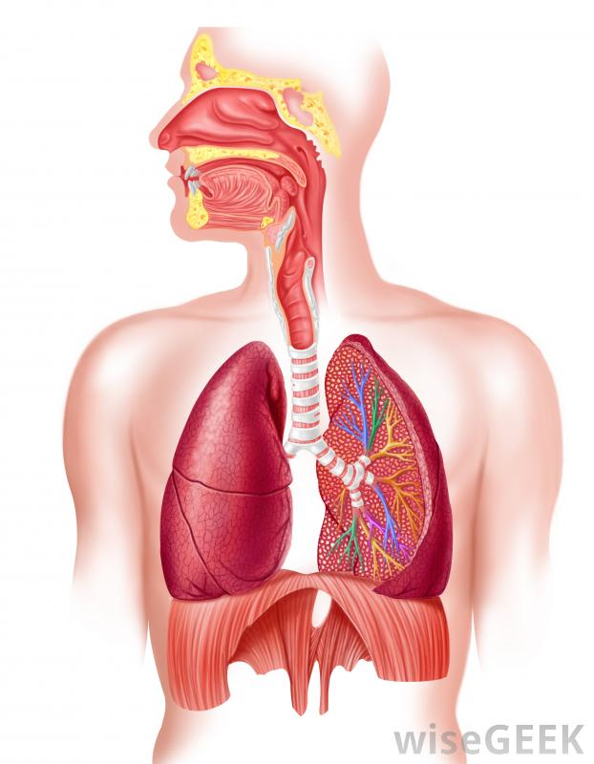
Human respiratory system and health problems
Olfactory region
Nasal cavity
Oral cavity
Respiratory symptoms
Asthma
Rhinitis
Coughing
Decreased lung function
Difficulty breathing
Translocate to other organs
Cardio-vascular diseases
Brain diseases
Adult diabetes
Cancer
Increase in plasma viscosity
Larynx
Trachea
Bronchi
Alveoli
Lung

Slide 6
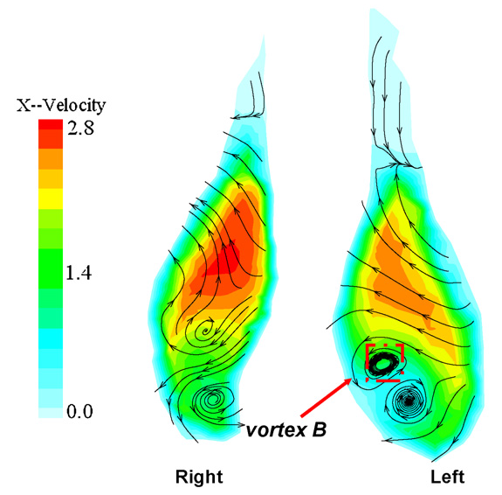
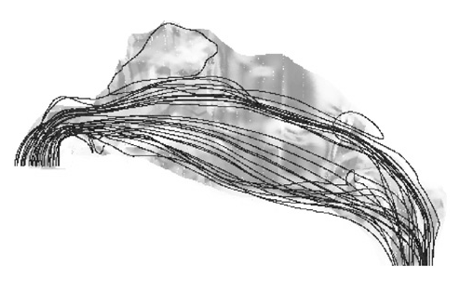
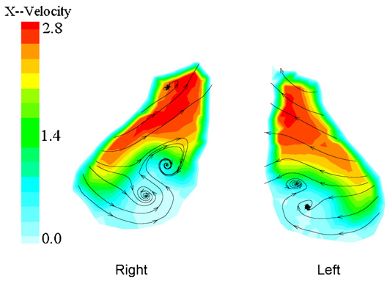
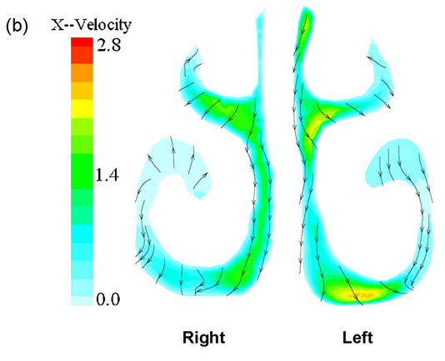
Airflow pattern in the nasal cavity
B
C
A
A’
B’
C’
B-B’: Anterior main passage
Research gaps:
Artificial nostril geometry
Uniform pressure inlet boundary
conditions at nostrils
A-A’: Nasal valve
C-C’: Turbinate

Slide 7
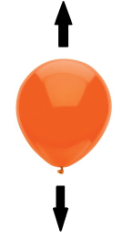
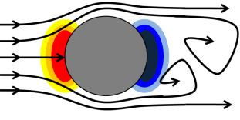
Forces acting on a particle
Bouyancy
Gravity
Micro-particles:
Nano-particles:
Drag force
Additional forces
Virtual force, body force,
Saffman lift force,
Magnus force,
Pressure gradient,
……
μ_{g}: Fluid viscosity
d_{p}: Particle size
C_{D}: Drag coefficient
Re_{p}: Reynold’s number
C_{c}: Cunningham correlation factor

Slide 8
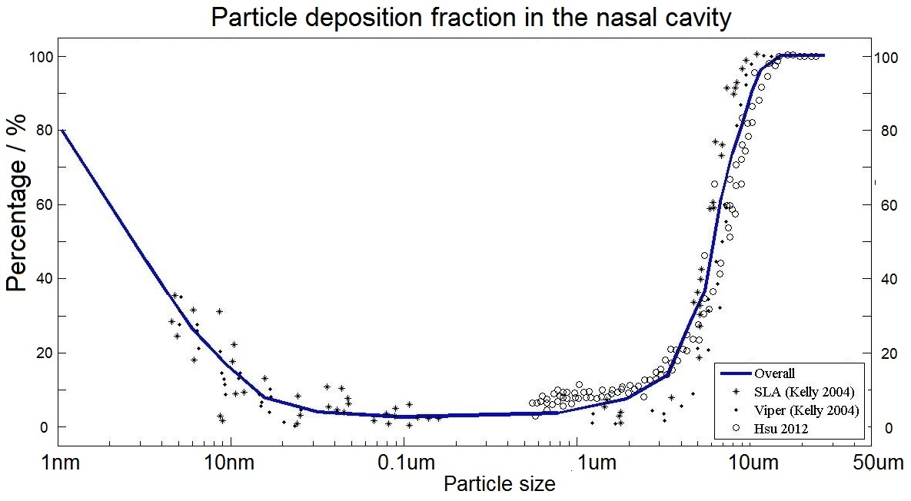
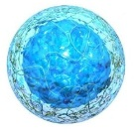
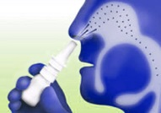
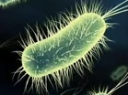

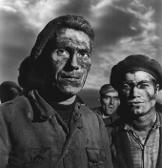

Particle deposition fraction in the nasal cavity
Rest breathing condition: 15 L/min
Nano-drug
Spray
Bacteria
Virus
Coal dust
Smoke
Nano Transitional Micro

Slide 9
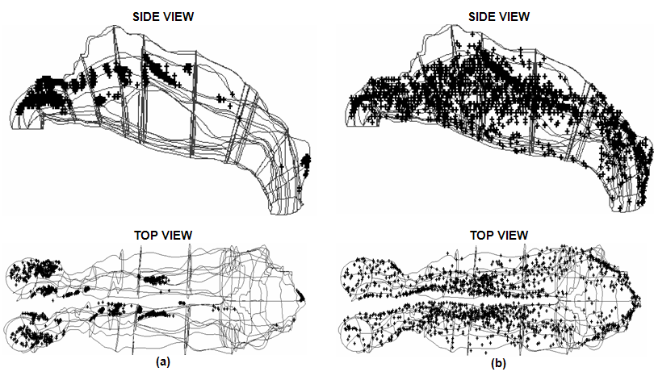
Particle deposition patterns overview
Micro-particles (22 µm) Nano-particles (1 nm)
1
Research gaps:
Particles were uniformly released from nostrils
Accurate deposition locations were not able
to visualized and analysed
spread around the whole cavity
2

Slide 10
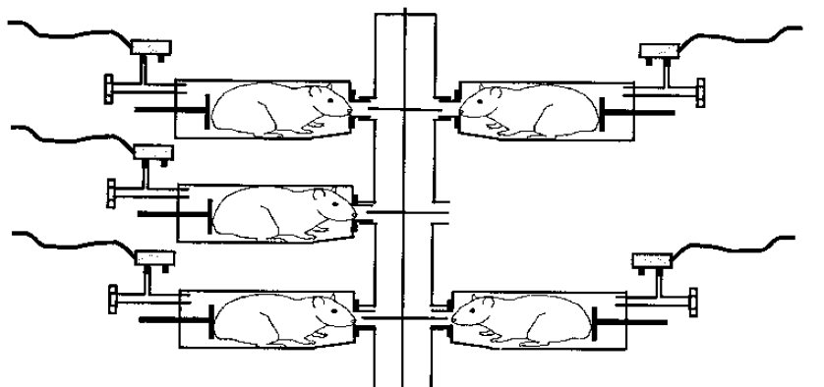
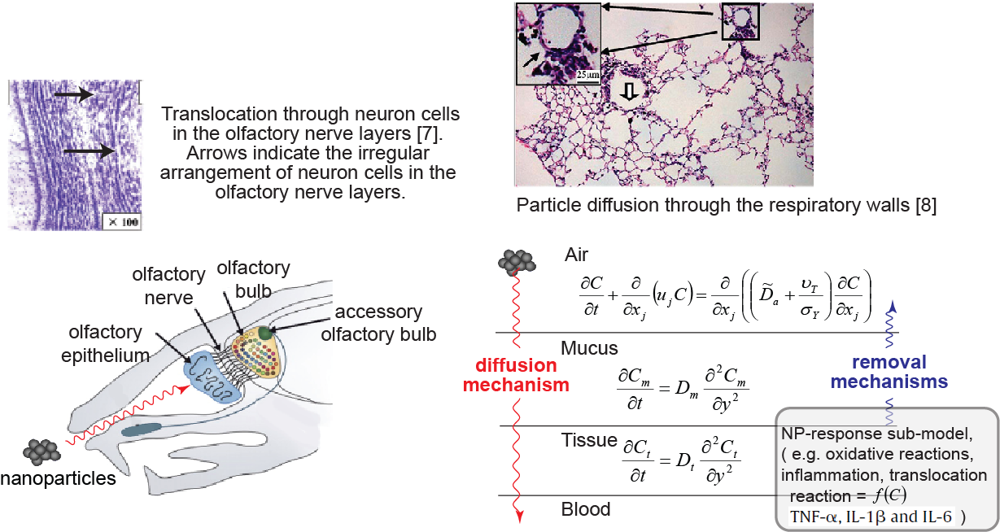
Experimental extrapolation
1
2
Research gaps:
Extrapolation from rat to human may not be reliable
Reconstructed models were truncated at the nostril
Rats in exposure chambers
Deposition patterns of 5 µm particles
Measurement of particle concentration in tissues
Deposition patterns of 1 nm particles

Slide 11
Research gaps
More high-quality nasal models need to be obtained and shared among researchers for detailed investigation.
It has been a challenge to visualize particle deposition patterns appropriately without being sheltered by the complicated nasal geometries.
The influence of the breathing region on incoming airflow and particle deposition patterns need to be investigated.
To build a direct extrapolation model from rat to human, comparative studies of particle deposition patterns between human and rat need to be investigated in detail.

Slide 12
Part 1:
Nasal geometry models reconstruction

Slide 13
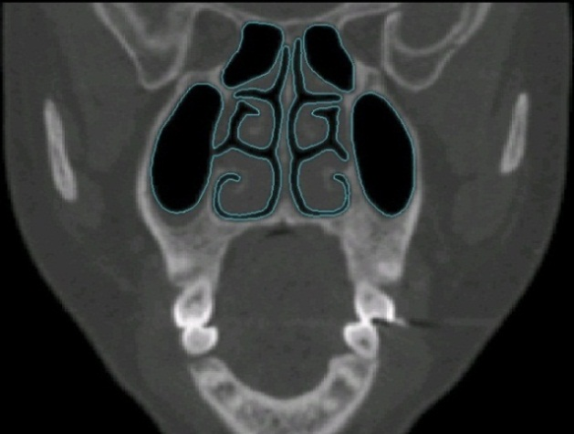
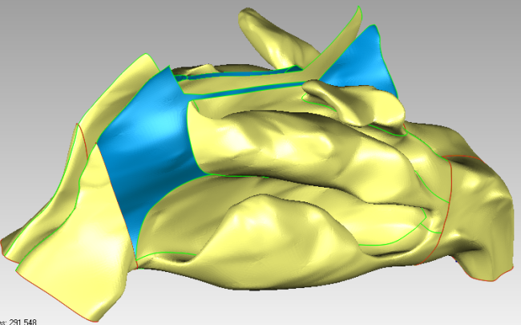
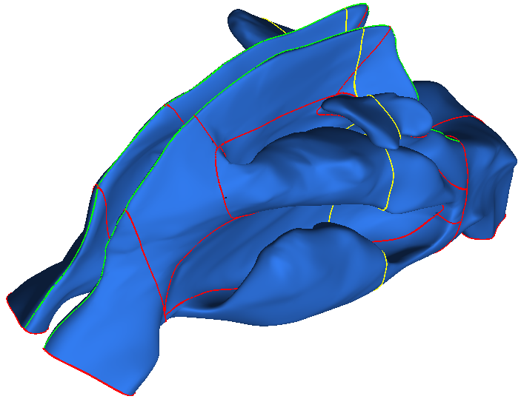
Nasal Model Acquisition
Image Acquisition
from CT / MRI data
View / Organize Images
1. Images
Processing
Manual
Segmentation
Automatic
Segmentation
Point Cloud Data
2. Model
Reconstruction
Manual Refinement
Automatic Surface Creation
Final Output Model (STL Format)
3. Further
Modification
CFD Meshing Software

Slide 14
CT Image Datasets Received Up to Date
CT set No. | Upload Date | Name | Age | Gender | Mode | Comments |  |  | Quality (1-5)
 |  |  |  |  |  | Nasal Passages | Lung | Oral Cavity
1 | 06/01/2014 | Shang Yi Dan | 24 | M | Standard | Yidan's NC. Cleaner in left cavity. | Whole | No | 2
2 | 07/01/2014 | ----------------------- | 60 | M | Standard | Clear and symmetric. | No | No | 3
3 | 13/01/2014 | ---------------------- | 51 | M | Standard | Narrow passages. Hard to reconstruct. | No | No | 2
4 | 14/01/2014 | ---------------------- | 22 | M | Standard | Terribly blocked. | Whole | No | 1
5 | 14/01/2014 | ---------------------- | 48 | M | Lung | Very nice. | Whole | Whole | 5
6 | 14/01/2014 | ---------------------- | 64 | M | Lung | Wide passages. Very clean. | Whole | No | 5
7 | 20/01/2014 | ---------------------- | 35 | F | Lung | Narrow passages. | Half | Half | 3
8 | 20/01/2014 | ---------------------- | 77 | M | Lung | Very nice. | No | Whole | 5
9 | 21/01/2014 | ---------------------- | 33 | M | Lung | Wider in right cavity. | No | No | 4
10 | 27/01/2014 | ---------------------- | 36 | M | Lung | Wider in right cavity. | Whole | No | 3
11 | 30/01/2014 | ---------------------- | 5 | F | Lung | Narrow. Symmetric. | Half | No | 4
12 | 03/02/2014 | ---------------------- | 37 | F | Lung | Very nice. Clean. | Half | No | 5
13 | 07/02/2014 | ---------------------- | 6 | M | Lung | Very narrow and complicated. | Whole | No | 3
14 | 26/03/2014 | ---------------------- | 50 | F | Lung | Clean. Narrow. | Half | No | 4
15 | 07/04/2014 | ---------------------- | 17 | M | Lung | Seriously blocked. | Half | Half | 1
16 | 25/04/2014 | ---------------------- | 25 | F | Lung | Clean. Wider in the left. | Half | No | 4
17 | 03/05/2014 | ---------------------- | 19 | F | Lung | Very clean. A little bit blocked. | Half | No | 4

Slide 15
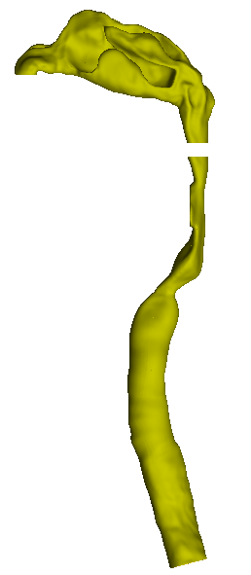
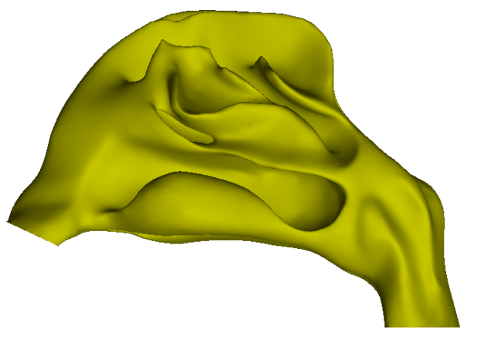
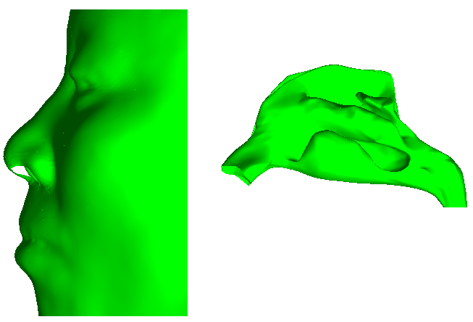
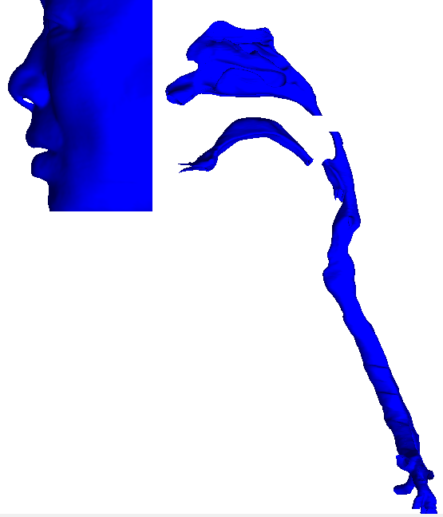
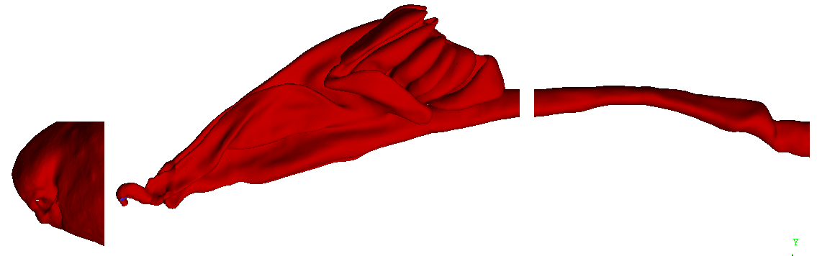
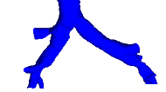
Models Reconstructed for Simulation
Nasal cavity Nasal cavity Face Nasal cavity
+
+
Larynx &
Trachea
NC01 NC02 NC03
+
Nasal cavity
+
NC05…
Nasal cavity
+
Larynx
Face
Oral cavity
Face
+
NC06…
+
Larynx &
Trachea
NC07…
Bronchi
NC04
RNC01

Slide 16
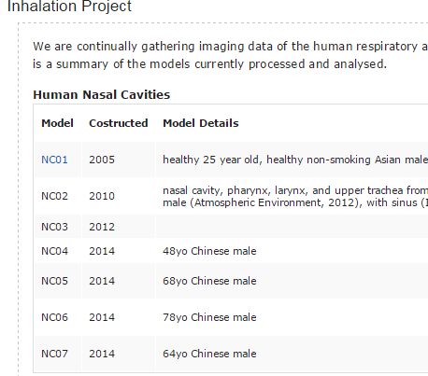

Respiratory models sharing platform
Source | # | Gender | Age
Olad data | 7a,b | M | 43
 | 9 | F | 41
 | 10 | M | 51
 | 15 | F | 56
 | 16a,b | M | 17
Scans from CS (1-10) | 1 | F | 63
 | 2 | M | 61
 | 3 | F | 53
 | 4 | F | 71
 | 5 | M | 36
 | 6 | M | 47
 | 7 | F | 25
 | 8 | F | 64
 | 9 | M | 52
 | 10 | F | 51
Scans from CA (11-20) | 11 | F | 44
 | 12 | F | 65
 | 13 | F | 61
 | 14 | M | 68
 | 15 | M | 50
 | 16 | M | 37
 | 17 | F | 56
 | 18 | F | 57
 | 19 | F | 30
 | 20 | F | 21
Scans from JY (1-4) | 1 | F | 42
 | 2 | M | 68
 | 3 | M | 41
 | 4 | F | 80
Total: | 29 | F | 17
 |  | M | 12
( http://www.cfdresearch.com/inhalation.php )
Project 1:
Project 2:
CFD GROUP at
RMIT University
Collaboration
Mark Jermy
Associate Professor at
University of Canterbury

Slide 17
Part 2:
A novel technique, Surface-mapping

Slide 18
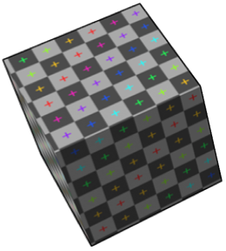
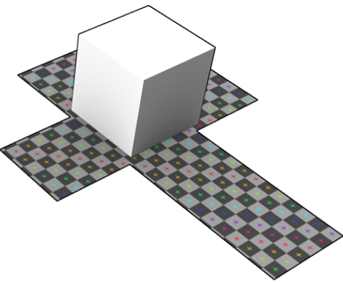
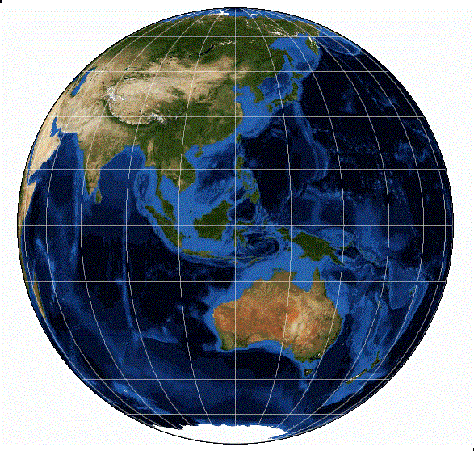
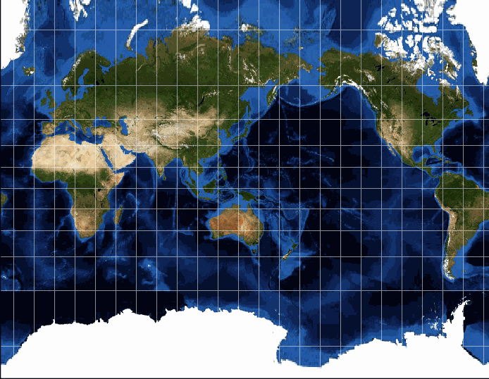
Surface-mapping examples
3D-Domain
2D-Domain
Transform
Transform
Notes:
Overview:
Committees, membership, agenda
Meeting
Following meeting: “housekeeping”, questions

Slide 19
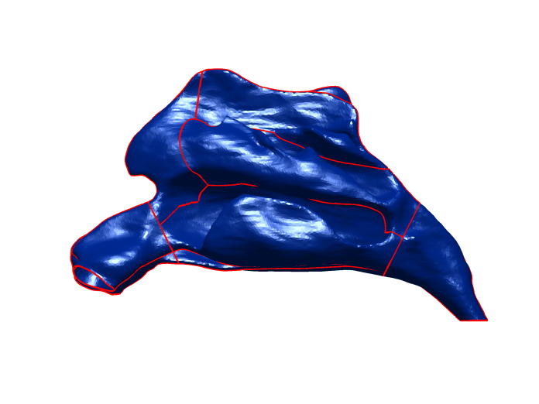
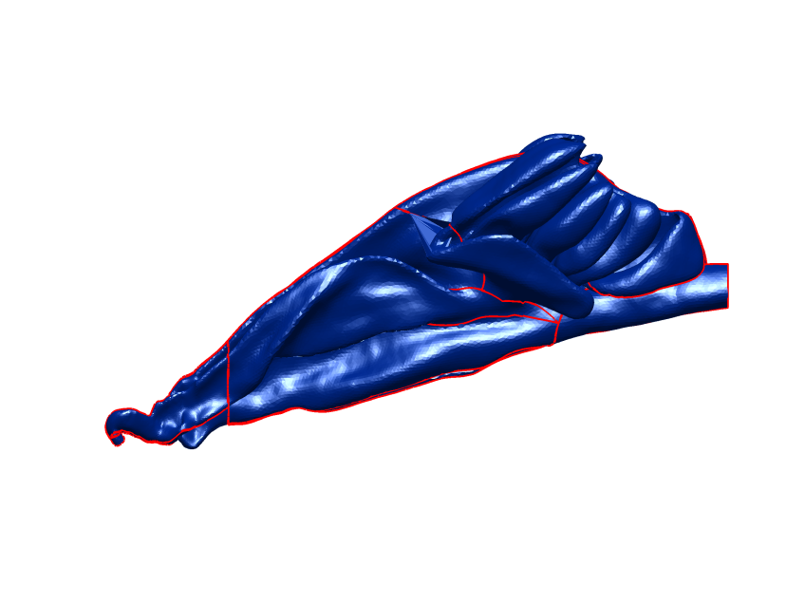
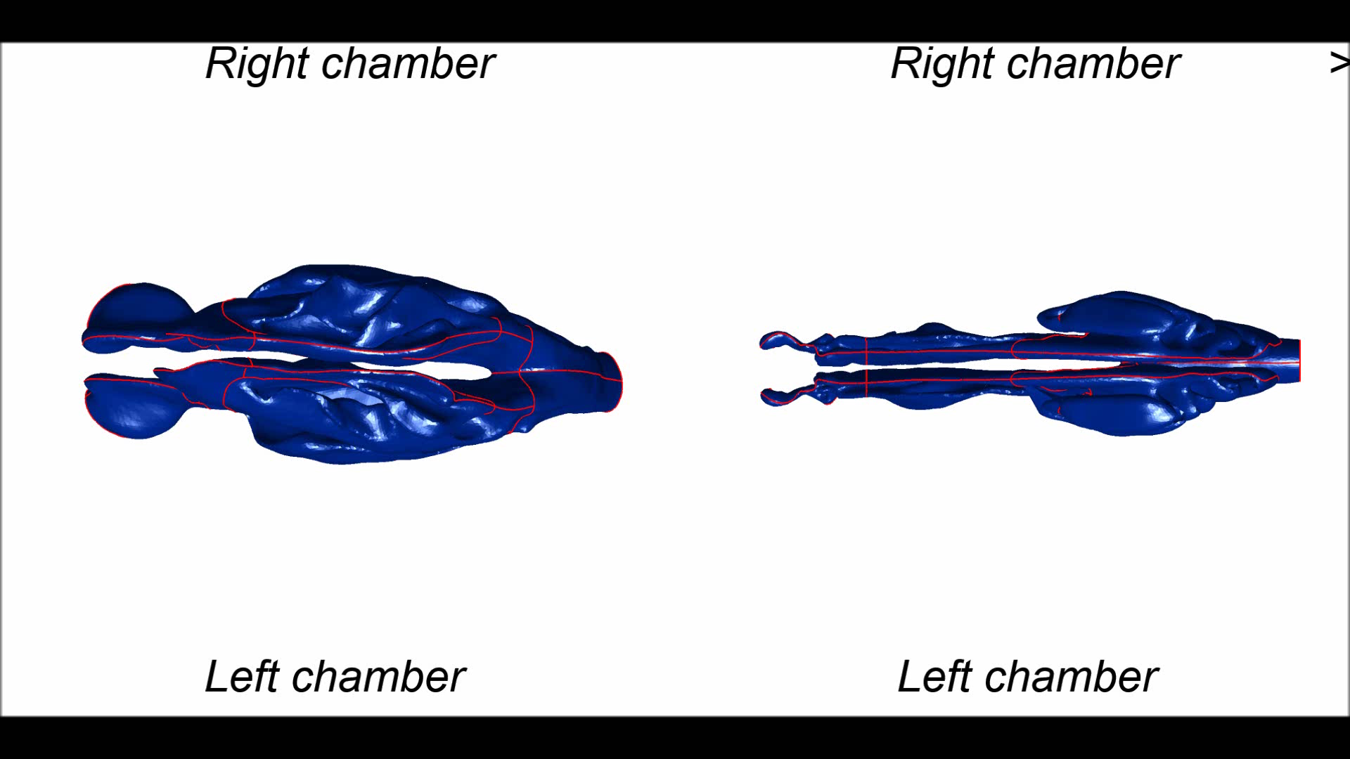
Human Rat

Slide 20
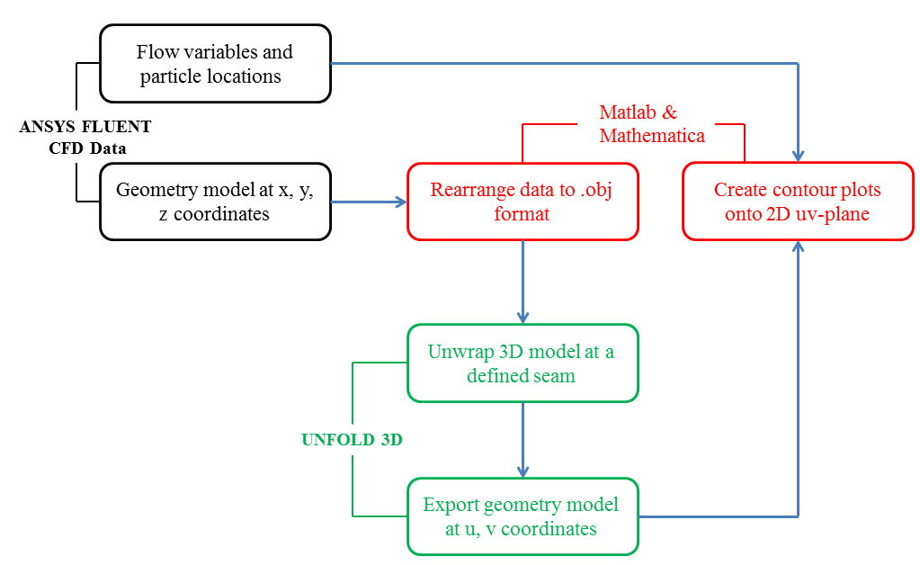



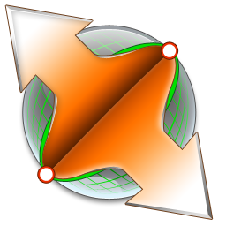
Connect CFD with Surface-mapping
5
1
2
3
4

Slide 21
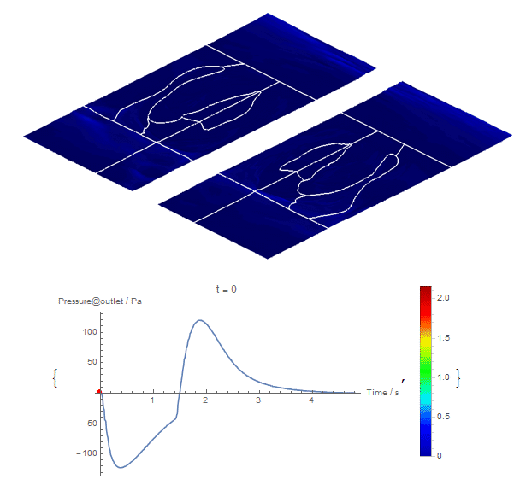
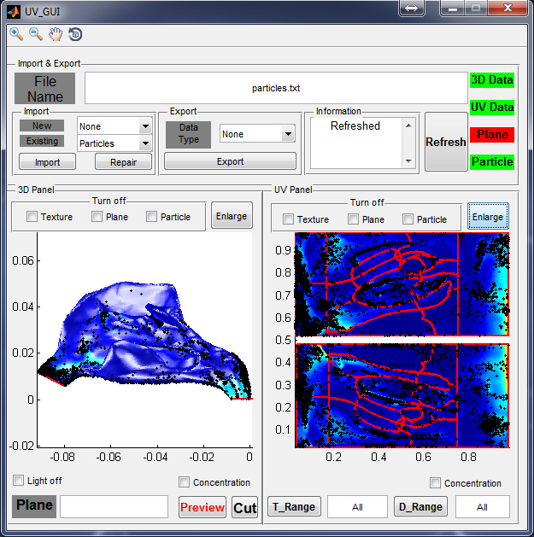
Surface-mapping applications
Right
Outlet
Inlet
Left
Wall shear stress map
during a respiratory cycle
User-Interface is available at:
http://www.cfdresearch.com/tt-uvUnwrapping.php
Journal publication: INTHAVONG, K., SHANG, Y. D. & TU, J. Y. 2014. Surface mapping for visualization of wall stresses during inhalation in a human nasal cavity. Respiratory Physiology & Neurobiology, 190, 54-61.

Slide 22
Part 3:
Particle deposition influenced by the breathing region

Slide 23
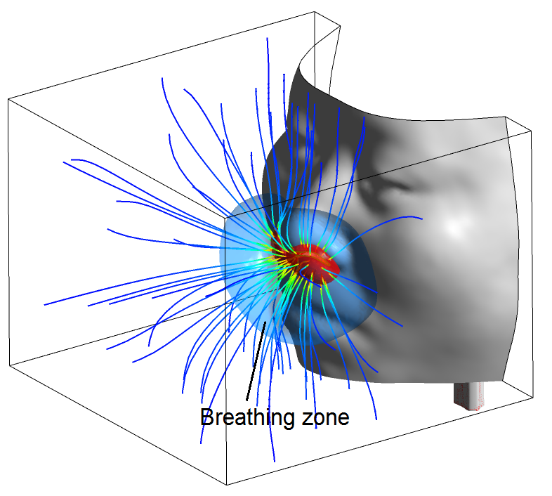
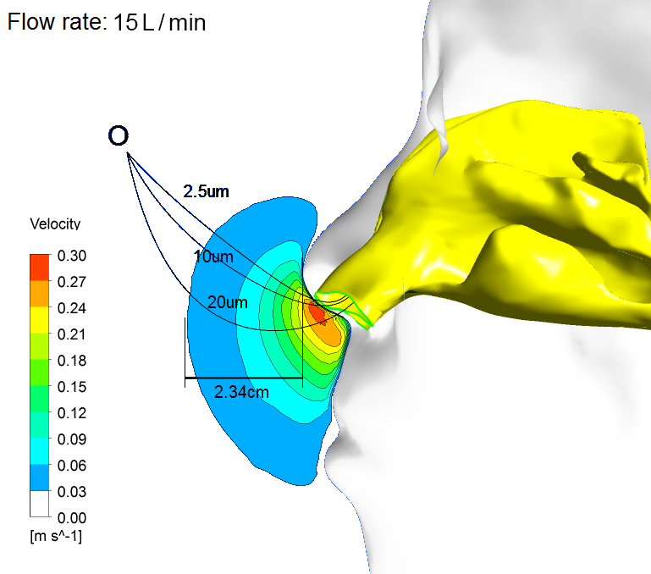
Airflow patterns and particle tracks at the outside air
0.03 m/s
0.3 m/s
Air streamlines
entering the breathing region
Tracks of 2.5/10/20 µm particles with background of the breathing region

Slide 24
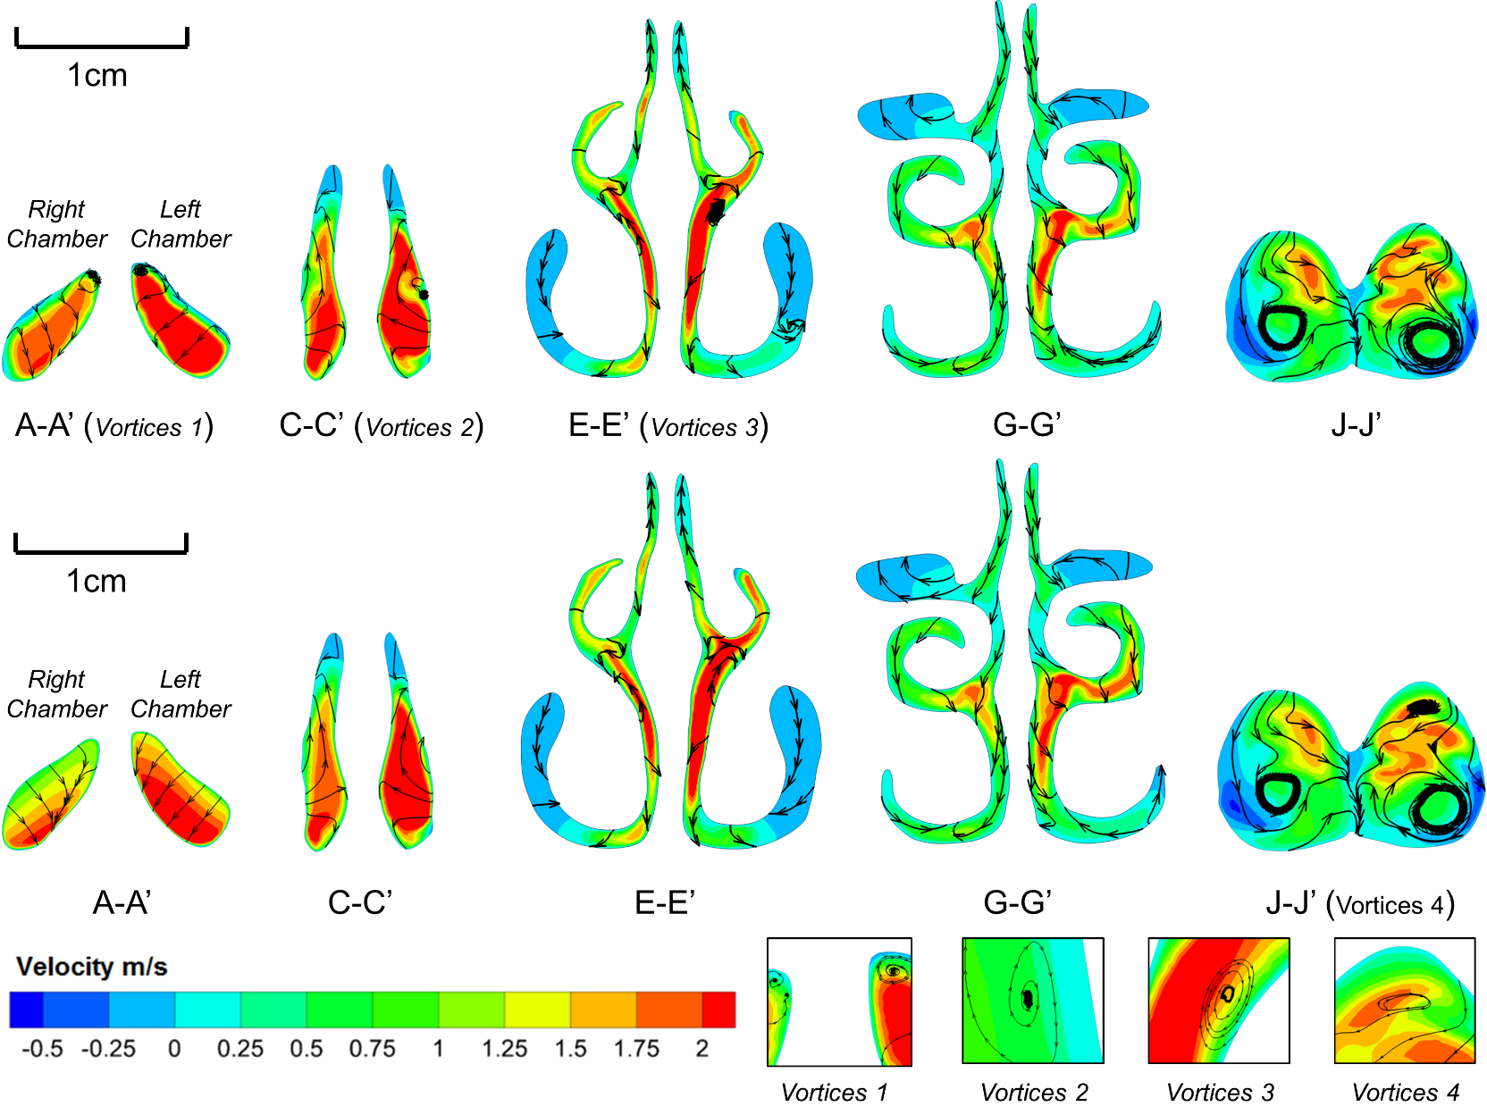
Comparisons of airflow contours along the nasal cavity
Nostril Post-valve Pre-turbinate Turbinate Post-nostril
With face
Nasal only
Colourmap
& Vortices

Slide 25
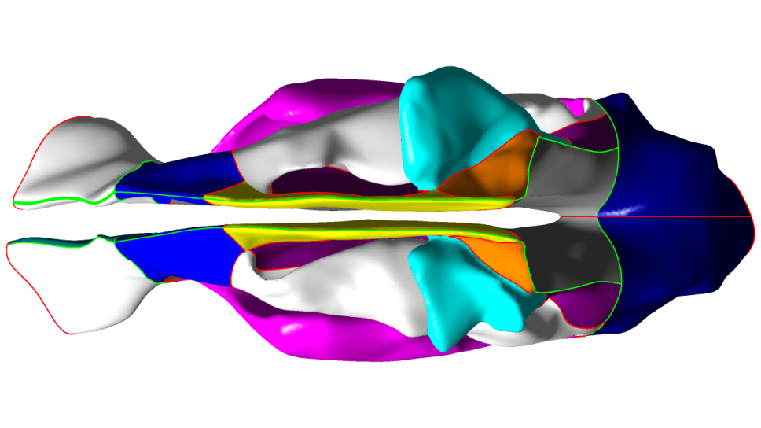
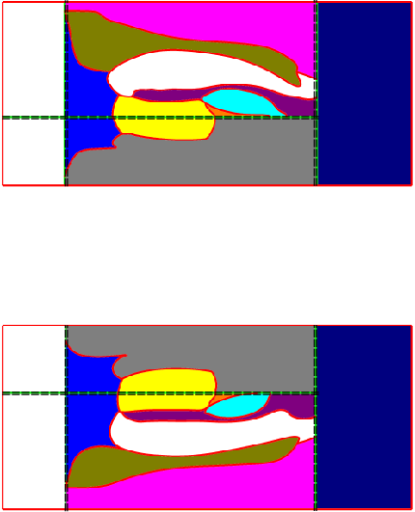
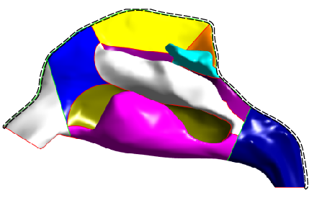
The division of nasal cavity in 3D and 2D domain
⑤
RIGHT CHAMBER
⑩
⑩
lateral
side
⑨
①
⑧
⑥
⑧
②
⑤
③
①
②
⑪
④
⑪
⑥
⑦
nasopharnx
②
⑤
③
④
①
⑧
⑥
septal
side
③
⑩
①. Vestibule ②. Atrium ③. Septum
④. Olfactory ⑤. Superior turbinate
⑥. Superior meatus ⑦. Middle turbinate
⑧. Middle meatus ⑨. Inferior turbinate
⑩. Inferior meatus ⑪. Pharynx
(a). Top view
④
LEFT CHAMBER
⑤
②
⑥
septal
side
③
⑧
④
⑨
⑦
①
②
⑥
⑦
①
⑧
⑪
⑩
lateral
side
⑪
⑨
⑩
(b). Lateral view
(c). Surface mapped view
⑤

Slide 26
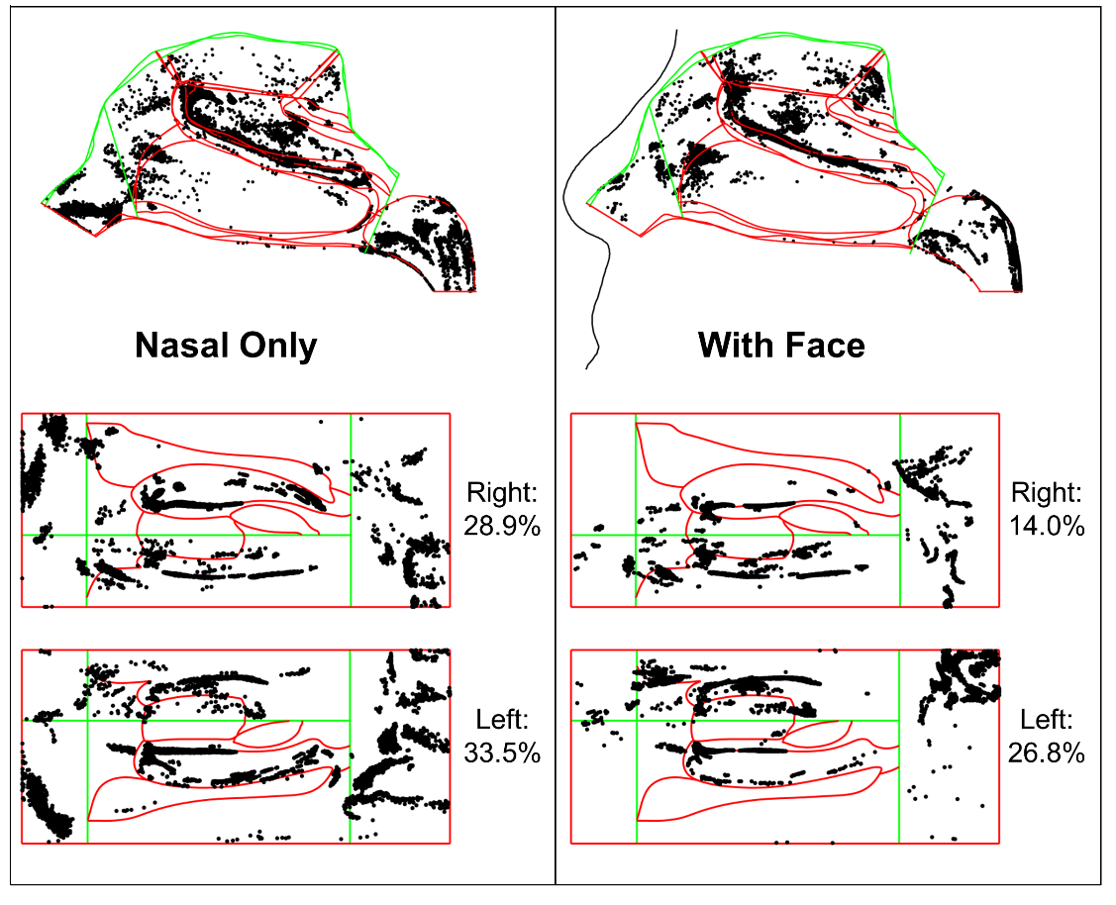

Comparisons of particle deposition in the nasal cavity
Comparison of
deposition fractions against inertial
Comparison of 10 µm particle deposition patterns
Paper publication:
SHANG, Y. D., INTHAVONG, K. & TU, J. Y. 2015. Detailed micro-particle deposition patterns in the human nasal cavity influenced by the breathing zone. Computers & Fluids, 114, 141-150.

Slide 27
Part 4: Comparative deposition study between human and rat

Slide 28

Comparison of human and rat nasal cavities
10 cm
1 cm
 | Length (cm) | Area (cm²) | Volume (cm³) | Olfactory area (%)
Human | 9.8 | 200 | 25 | 10
Rat | 3.6 | 23 | 0.65 | 56
Human/Rat | 2.7 | 8.7 | 38.5 | 1/5.6

Slide 29

Comparisons of airflow patterns
Similarities
Small breathing regions
Flow acceleration at nostril
Flow recirculation in olfactory regions
Differences
Two filtering bends in rat’s vestibule
Higher air velocity in rat’s nasal cavity
Rat’s olfactory region is more complicated
Fewer air entering into rat’s olfactory region

Slide 30

Regional division of human and rat nasal cavities

Slide 31



Validation of micro-particles depositions
Particle release location for the human case
Particle release location for the rat case
Total particle deposition fraction against particle size
Total particle deposition fraction against particle size

Slide 32


Comparisons of micro-particle deposition patterns
Total deposition
Total deposition
Size (µm) | DF (%)
2.5 | 3.4
9 | 40
20 | 100
Size (µm) | DF (%)
1 | 3
2 | 40
3 | 100
Paper publication: SHANG, Y. D., DONG, J. L., INTHAVONG, K. & TU, J. Y..
Comparative numerical modelling of inhaled micron-sized particle deposition in human and rat nasal cavities. Inhalation Toxicology (Accepted)

Slide 33


Validation of nano-particles depositions
Particle release location for the human case
Particle release location for the rat case
Total particle deposition fraction against particle size
Total particle deposition fraction against particle size

Slide 34


Comparisons of nano-particle deposition patterns
Total deposition
Total deposition
Size (nm) | DF (%)
1 | 70.9
10 | 17.1
100 | 6.58
Size (nm) | DF (%)
1 | 96.7
10 | 24.5
100 | 8.11

Slide 35


Comparisons of nano-particle density contours
1 nm particles
1 nm particles
lateral
lateral
septal
septal
Hot spots: top of vestibule,
middle turbinate, upper septum
Hot spots: lateral vestibule, bottom of vestibule,
middle turbinate, middle of septum

Slide 36


Extrapolation mathematical modelling
$$f = \frac{{n_{regional}}/{n_{total}}}{{A_{regional}}/{A_{total}}}$$
Normalised deposition flux:
Extrapolation table for nano particles
Paper publication: DONG, J. L., SHANG, Y. D., INTHAVONG, K. & TU, J. Y..
Comparative numerical modelling of inhaled nano-sized particle deposition in human and rat nasal cavities. Toxicology of Sciences (Writing)

Slide 37
Conclusion and future works
A new respiratory geometry models database will be established with global collaboration.
The surface-mapping technique was introduced and developed to standardise visualisation method of regional deposition patterns in human/rat (and so on) nasal cavities. This will promote clinical application of estimating the preferred particle deposition sites.
The influence of facial features on particle deposition patterns in human nasal cavity was investigated and found that the face is highly recommended to be included in the simulation.
Comparative study of particle deposition patterns between human and rat was investigated to help establish the reliable extrapolative model from rat to human.
Oral cavity, lower respiratory tract (larynx, trachea, bronchi) and lung need to be investigated.
The process of particles dissolving in mucus, penetrating through tissue and diffusing into blood vessels need to be simulated.

Slide 38
Title of Activity | Timelines PhD Quarters
 | 1 | 2 | 3 | 4 | 5 | 6 | 7 | 8 | 9 | 10 | 11 | 12 | 13 | 14 | 15 | 16
1. Literature review
2. Reconstruct human CT scan to computational model
3. Reconstruct rat CT scan to computational model
4. Design and improve strategies for surface-mapping technique
5. Compare airflow field and particle deposition patterns between human nasal models
6. Compare airflow field and particle deposition patterns between human and rat models
7. Journal and conference publication
8.Thesis Write-up
Completed
Future plan

Slide 39
Acknowledgment
Professor Jiyuan TU
Dr. Kiao INTHAVONG
CFD Group
SAMME, RMIT
Committee

Slide 40
Publication
Journal papers
1. SHANG, Y. D., INTHAVONG, K. & TU, J. Y. 2015. Detailed micro-particle deposition patterns in the human nasal cavity
influenced by the breathing zone. Computers & Fluids, 114, 141-150.
2. SHANG, Y. D., DONG, J. L., INTHAVONG, K. & TU, J. Y.. Comparative numerical modelling of inhaled micron-sized
particle deposition in human and rat nasal cavities. Inhalation Toxicology (Accepted).
3. SHANG, Y. D., DONG, J. L., INTHAVONG, K. & TU, J. Y.. Comparative numerical modelling of inhaled nano-sized
particle deposition in human and rat nasal cavities. Toxicology of Science (Writing)
4. INTHAVONG, K., SHANG, Y. D. & TU, J. Y. 2014. Surface mapping for visualization of wall stresses during inhalation in
a human nasal cavity. Respiratory Physiology & Neurobiology, 190, 54-61.
5. LI, X., YAN, Y., SHANG, Y. & TU, J. 2015. An Eulerian–Eulerian model for particulate matter transport in indoor spaces.
Building and Environment, 86, 191-202.
6. INTHAVONG, K., SHANG, Y. D., TU, J., Micro and nano-particle inhalation and deposition in nasal cavities from outside
air. (Writing)
7. LI, Z., MUMFORD, K. A., SHANG, Y. D., SMITH, K. H., CHEN, J., WANG, Y. & STEVENS, G. W. 2014. Analysis of the
Nonrandom Two-Liquid Model for Prediction of Liquid-liquid Equilibria. Journal of Chemical and Engineering Data, 59,
2485-2489.
8. TIAN, L., INTHAVONG, K., LIDEN, G., SHANG, Y. D., TU, J. Transport and deposition of welding fume agglomerates in
a realistic human nasal airway (Submitted)
Conference papers
1. SHANG, Y., INTHAVONG, K. & TU, J. 2013. Application of Surface Mapping to Visualize Wall Shear Stress and
Particles Deposition in a Realistic Human Nasal Cavity. APCOM & ISCM 2013, Singapore.
2. SHANG, Y., DONG, J. L., INTHAVONG, K., & TU, J. 2015. How reliable is the extrapolation? Localized particle
deposition patterns in human/rat nasal cavities. IMECE 2015, Houston

Slide 41

Thanks for your attention!

Slide 42



Indoor pollutants
Volatile organic compounds (VOCs)
Formaldehyde
Ozone
Carbon monoxide
Pesticides
Virus
Bacteria
Virus
Bacteria
Virus
Bacteria

Slide 43

Medical Particles

Slide 44

Upper airway and paranasal sinuses
Brain
Oral cavity
Notes:
"Paranasal" means near the nose. The paranasal sinuses are hollow, air-filled spaces in the bones around the nose. The sinuses are lined with cells that make mucus, which keeps the inside of the nose from drying out during breathing.
There are several paranasal sinuses named after the bones that surround them:
The frontal sinuses are in the lower forehead above the nose.
The maxillary sinuses are in the cheekbones on either side of the nose.
The ethmoid sinuses are beside the upper nose, between the eyes.
The sphenoid sinuses are behind the nose, in the center of the skull.
Nasal cavity
The nose opens into the nasal cavity, which is divided into two nasal passages. Air moves through these passages during breathing. The nasal cavity lies above the bone that forms the roof of the mouth and curves down at the back to join the throat. The area just inside the nostrils is called the nasal vestibule. A small area of special cells in the roof of each nasal passage sends signals to the brain to give the sense of smell.
Together the paranasal sinuses and the nasal cavity filter and warm the air, and make it moist before it goes into the lungs. The movement of air through the sinuses and other parts of the respiratory systemhelp make sounds for talking.

Slide 45



Particle path to airway
Airflow
path
Particles

Slide 46



Apply UV-Mapping method to Nasal Cavity
Cut surface along
black curves
Divide nasal cavity
Into left and right
Unwrap
Right Cavity
Lateral
Normalize
Septal
Outlet
Inlet
Left Cavity
Lateral

Slide 47






15 cm
Extension
12 cm
E’
F’
G’
D’
H’
G - G’
C’
I’
B’
J’
(a). Front view
K’
A’
B
L’
A
C
D
E
F
G
H
I
J
K
L
M’
M
20 cm
C - C’
J - J’
(b). ISO view
(c). Cross-sectional area (CSA) distributions

Slide 48




Mesh Generation
Detailed mesh structures
Mesh outside the nasal cavity
Velocity boundary condition
G’
G
Mesh at the turbinate cross section
Mesh inside the nasal cavity

Slide 50
Geometrical comparison of major anatomical regions for rat and human nasal models.
Region ID | Region name | Surface area of Rat RNC01 (mm²) | Percentage of surface area (%) |  | Surface area of Human NC04 (mm²) | Percentage of surface area (%)
 |  |  | Present model | Literature |  | Present model | Literature
1 | Vestibule | 134 | 5.8% | 4.4%^{b}, 4.0%^{d}, 3~4%ª | 1571 | 7.9 % | 8.2% ^{b}, 6.2% ^{d}
2 | Upper passage | 119 | 5.1% |  | 566 | 2.8%
3 | Middle passage | 241 | 10.3% |  | 5343 | 26.9%
4 | Lower passage | 140 | 6.0% |  | 5147 | 25.9%
5 | Olfactory | 1294 | 55.6% | 41.8%^{b}, 40.6%^{c}, 50~52%ª | 2097 | 10.5% | 9.5%^{b}
6 | Septum | 308 | 13.3% |  | 3939 | 19.9%
7 | Pharynx | 89 | 3.9% |  | 1220 | 6.1%
Total Area(mm2) |  | 2325 | 100% |  | 19882 | 100%
 |  | Rat NC04 |  |  | Human NC04
Nasal Volume (mm³) |  | 653.2 |  |  | 25267.4
Characteristic length d_{c} (mm) |  | 0.28 |  |  | 1.27
ª Gross et al. (1982), ^{b} Schroeter et al. (2008), ^{c} Garcia and Kimbell (2009), ^{d} Schroeter et al. (2014)

Slide 51

Table 1. Extrapolation table for micro particles

Slide 52

Next research
I’ll continue working on a comparative study of inhaled particle deposition in rat and human nasal cavities;
More computational models will be reconstructed and effects of inhaled particles on human nasal cavities of different individuals will be compared;
Based on the mapped flat domain, the new diffusion domains and high quality thin mesh layers will be created by Matlab. Particle-tissue reaction process will be simulated in the future research.
Particle path

